Slide 1

Statistical Shape Analysis #1 – Concepts and Landmarks
A. Murat Maga, PhD
Associate Professor
University of Washington
Division of Craniofacial Medicine
Department of Oral Biology (adjunct)
Department of Anthropology (adjunct)
&
Seattle Children’s Research Institute
Center for Developmental Biology and Regenerative Medicine

Slide 2
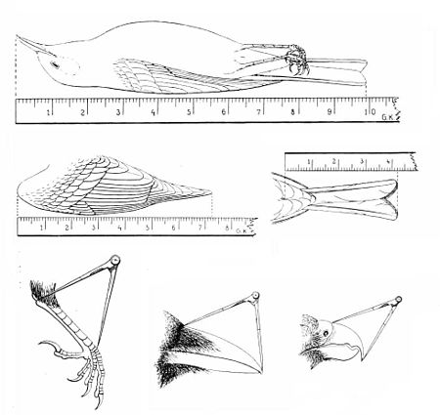
Traditional Morphometrics
Traditional morphometrics analyzes lengths, widths, masses, angles, ratios and areas.
These data are also useful when size measurements are of theoretical importance such as body mass and limb cross-sectional area and length in studies of functional morphology. However, these measurements have one important limitation: they contain little information about the spatial distribution of shape changes across the organism.

Slide 3
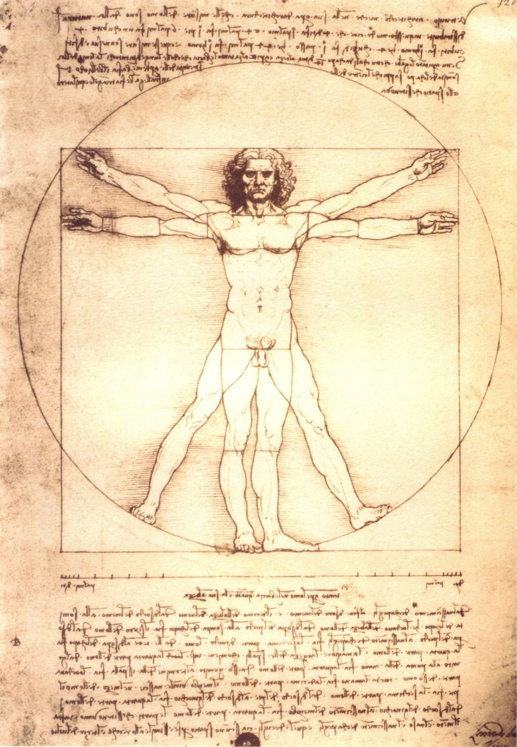
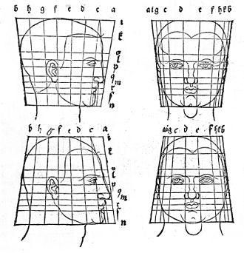
Study of organismal form (1500s)
Leonardo Da Vinci
Albrecht Dürer
Notes:
So a little bit of history first. As most scientific disciplines, we can trace the history of study of the biological form into renaissance and earlier. I brought these two contemporaries up because they represent the two different traditions of looking at biological form.
In a nutshell, Da Vinci studies proportions of segments, whereas Durer geometric transformations. First approach can be broadly categories as the ‘traditional morphometrics’, that is the biological form of is described series of measurements or ratios. The second variety, focuses on geometric transformations.
We will focus on the latter variety as they are inherently more suitable multivariate analysis of covariation (for reasons that I will not describe but hopefully will be clear as we go).

Slide 4
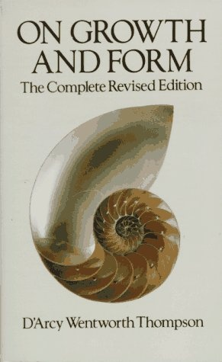
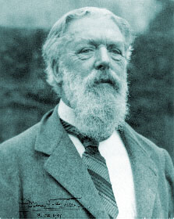
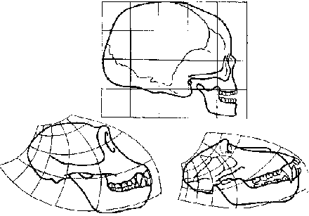
Study of Organismal form (1900s)
Notes:
D’arcy Thompson is a pioneer of what today we would call mathematical biology. His work is greatly admired by biologists, anthropologists and architects among others, but has the dubius distinct of “less often read than cited”.^{[1]}
This is typically attributed to the his complete failure (or glaring omission) to understand the role of evolution and evolutionary history in shaping living structures.
Among the many interesting studies he presented, a particularly interesting one is the geometric transformation of a human skull to a chimpanzee and to a baboon. He did not described his graphical technique explicitly enough for any to repeat it.

Slide 5
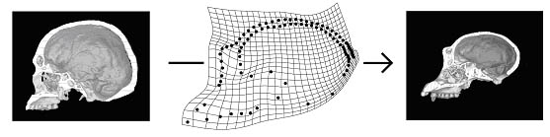
Thin-Plate Spline (TPS) deformations
Bookstein FL. 1989. Principal warps: thin-plate splines and the decomposition of deformations. IEEE Transactions on Pattern Analysis and Machine Intelligence 11:567–585.
Notes:
So in the end, we have a formal method that reliably estimates transformations of one shape configuration to the other and provide a visual of the deformation field. We can then compare these deformation fields statistically between groups, test whether they are related with any categorical variables (sex, age, genotype, case control status etc).
Since then there is the whole field of neuroimaging that focused on one thing and one thing only, comparing the shapes of human brains and their substructures in 3D. There are many different algorithms with widely differing mathematical basis, but in the end they all do the same thing. Calculate a transformation of one structure to the other and the apply statistics to those deformation fields. Yet, landmark based shape analysis remain fairly heavily used, because requirements are very simple. All you need is some way of digitizing your structure of interest and then the ability to pick identical structure. It is particularly appealing for anatomical structure where the variation is preferentially embedded in 2D (think of fly wings, or corpus callosum).

Slide 6
What is biological shape/form?
Biological shape is the residual information left after differences in translation, rotation and uniform size is removed from the data.
Biological form is the residual information left after only differences in translation and rotation is removed from data. (Size becomes part of the analysis).
Notes:
So how to we define biological shape. Some definitions here.

Slide 7
Shape vs form
Same shape (circle), but different forms (small vs big).
Notes:
So how to we define biological shape. Some definitions here.

Slide 8
Shape vs form
What about these?
Notes:
So how to we define biological shape. Some definitions here.

Slide 9
Shape vs form
To decide we have to establish some sort of correspondence (or mapping) between these shapes.
Notes:
So how to we define biological shape. Some definitions here.

Slide 10
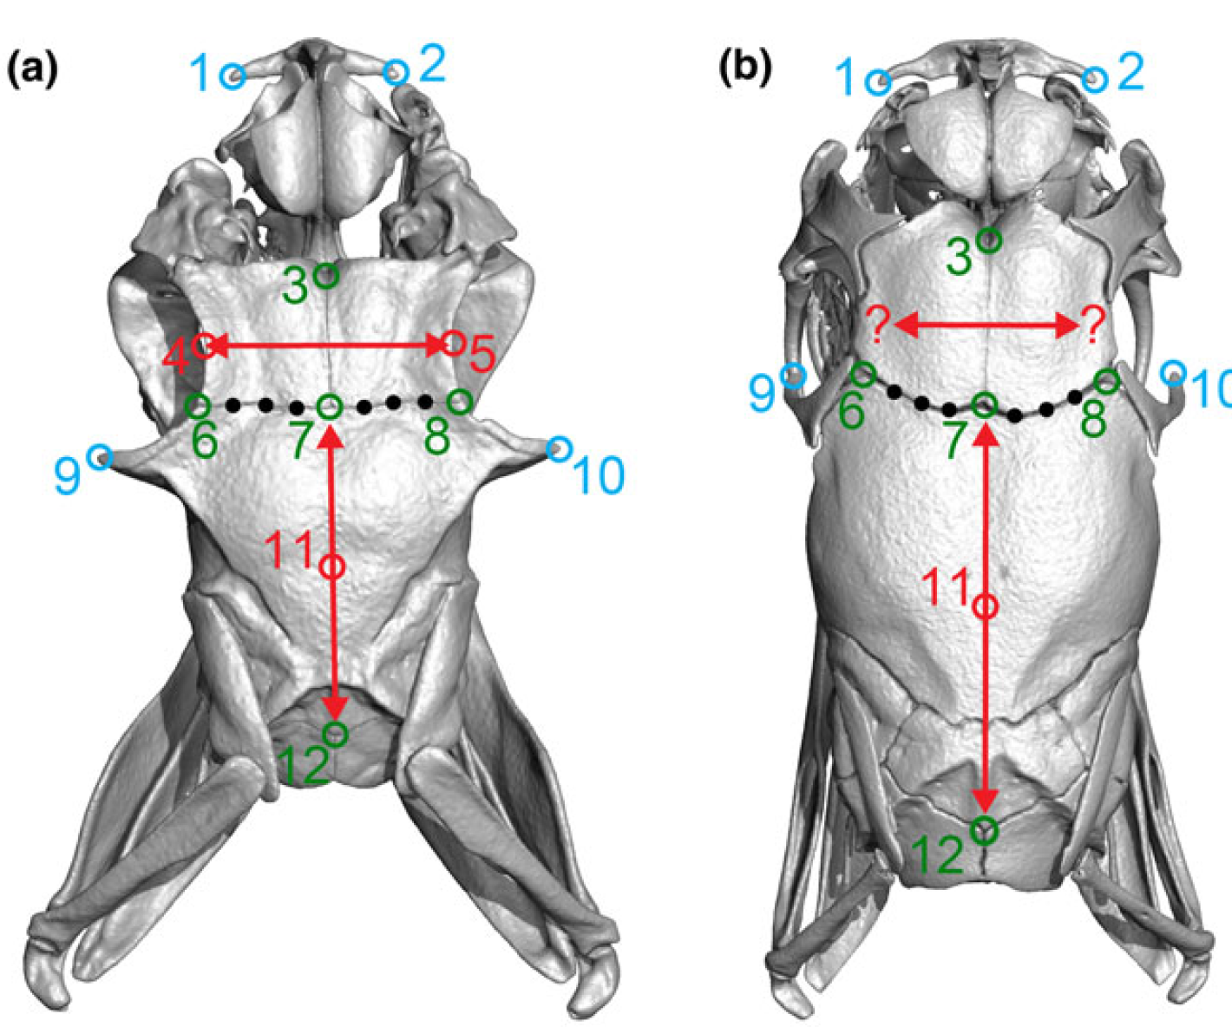
Homology and types of landmarks
Type I: juxtaposition of tissue or foramina
Type II: self-evident geometry (tips of prominences or notches)
Type III: geometric construction (e.g., deepest point in the notch)
Semi-landmarks (we have a lecture dedicated to them)
Figure from: Palci, Alessandro, and Michael S. Y. Lee. “Geometric Morphometrics, Homology and Cladistics: Review and Recommendations.” Cladistics 35, no. 2 (2019): 230–42. https://doi.org/10.1111/cla.12340.
Notes:
But what is homology? Biological, mathematical/geometric?

Slide 11
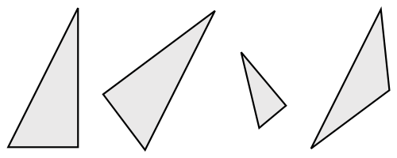
Putting all together
Original Configurations
Scaling
Rotation
Iterations to minimize the difference
Superimposition
Generalized Procrustes Analysis (or GPA)
Gower JC. 1975. Generalized procrustes analysis. Psychometrika 40:33–51.
Kendall DG. 1984. Shape Manifolds, Procrustean Metrics, and Complex Projective Spaces. Bull London Math Soc 16:81–121.
Rohlf FJ, Slice D. 1990. Extensions of the Procrustes Method for the Optimal Superimposition of Landmarks. Systematic Zoology 39:40–59.

Slide 12
Some Definitions
Procrustes coordinates: New set of coordinates after GPA
Consensus (mean) shape: The average of individual landmarks (red triangle)
Procrustes residuals: [Procrustes coordinate – consensus shape]; i.e. description of how each individual different from the consensus. (vector defined by the dashed line)
Procrustes distance: The squared sum of these differences, i.e., measure of how far the individual is from the mean (dashed lines).
https://life.bio.sunysb.edu/morph/glossary/gloss1.html
https://life.bio.sunysb.edu/morph/glossary/gloss2.html

Slide 13
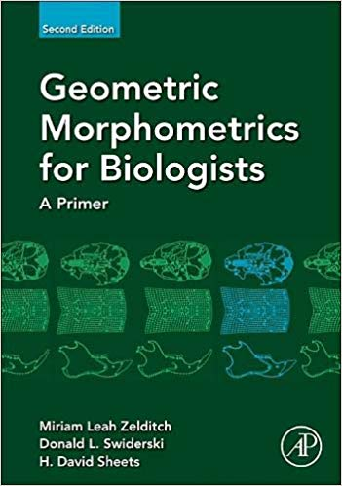
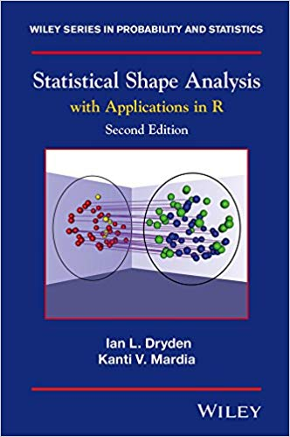
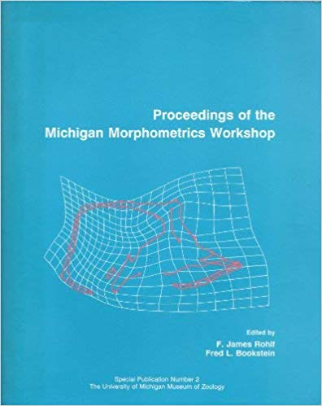
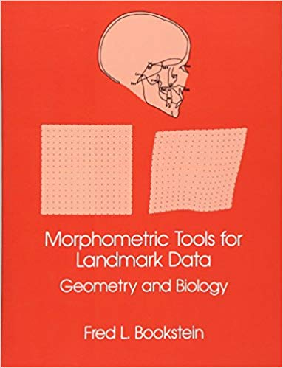
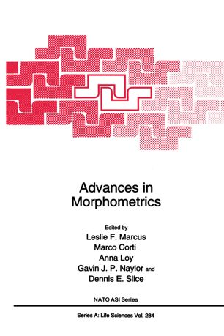
Textbooks
Also a short online paper https://geosci.uchicago.edu/~mwebster/Webster_and_Sheets_2010.pdf
A Practical Introduction to Landmark-based Geometric Morphometrics

Slide 14
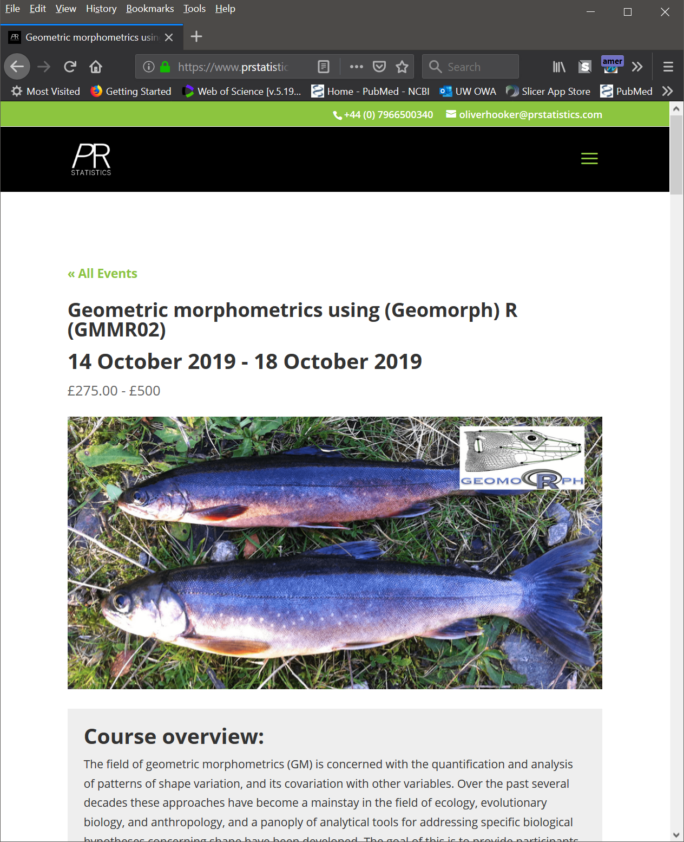
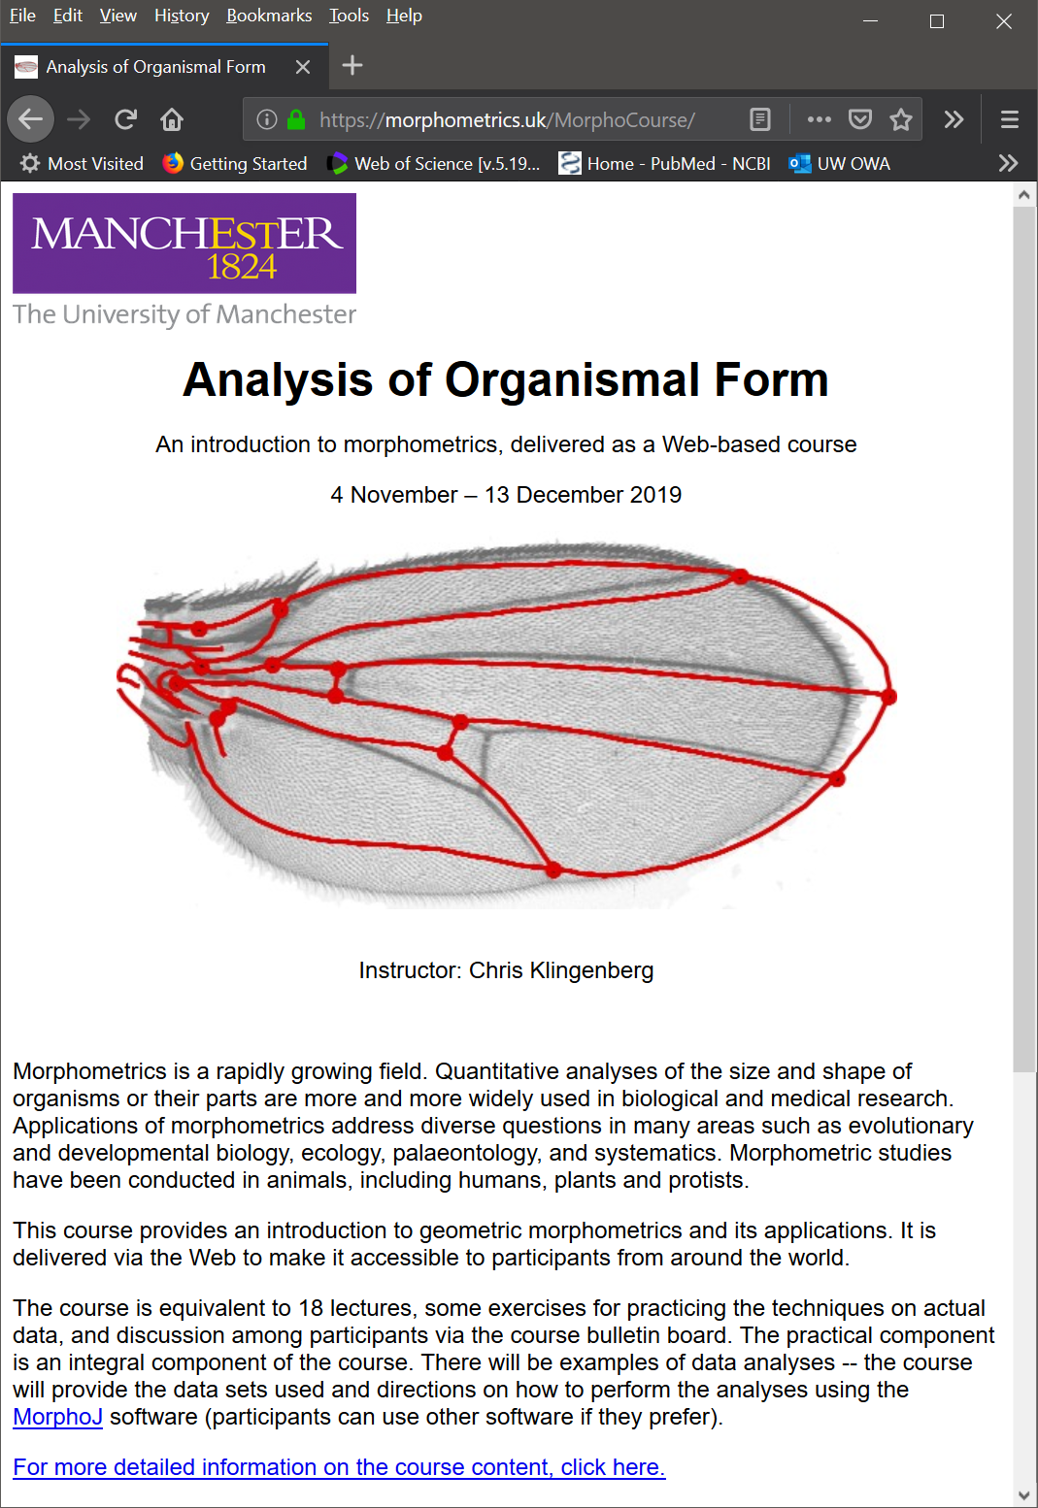
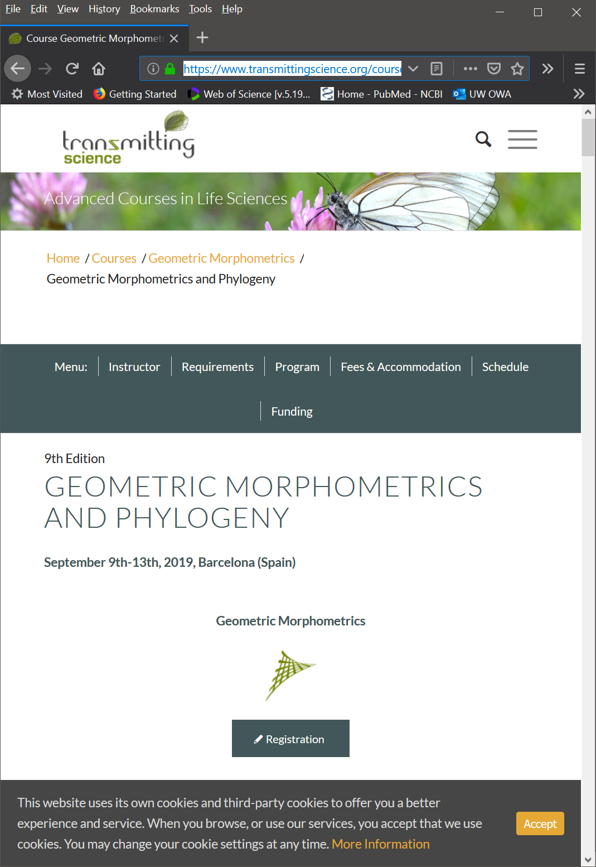
Geometric morphometrics specific short courses
https://www.prstatistics.com/course/geometric-morphometrics-using-r-gmmr02/ (Dean Adams)
https://morphometrics.uk/MorphoCourse/ (Chris Klingenberg)
https://www.transmittingscience.org/courses/geometric-morphometrics/geometric-morphometrics-phylogeny/

Slide 15
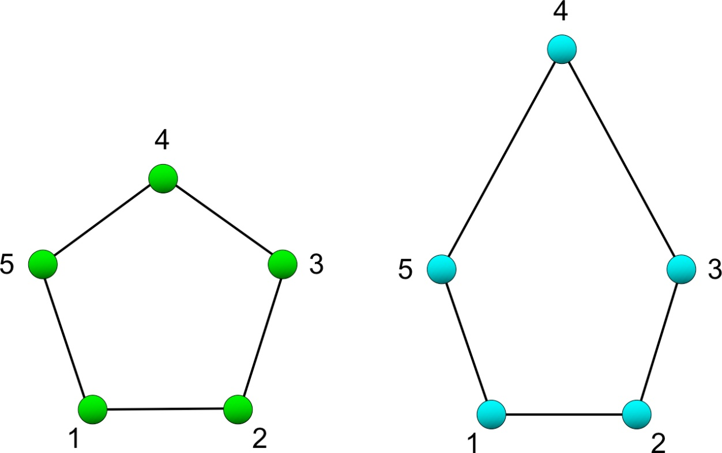
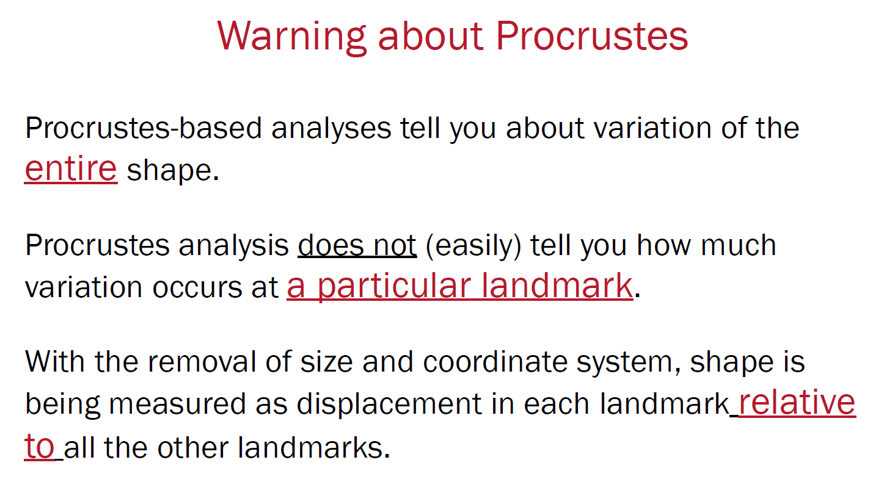
GPA Gotchas
In Generalized Least Squares (GLS) method of optimization variance will be distributed across landmarks. *
Notes:
* But you can still calculate landmark specific variances. It is useful for detecting ‘abnormal’ LMs (possibly digitization issues).

Slide 16
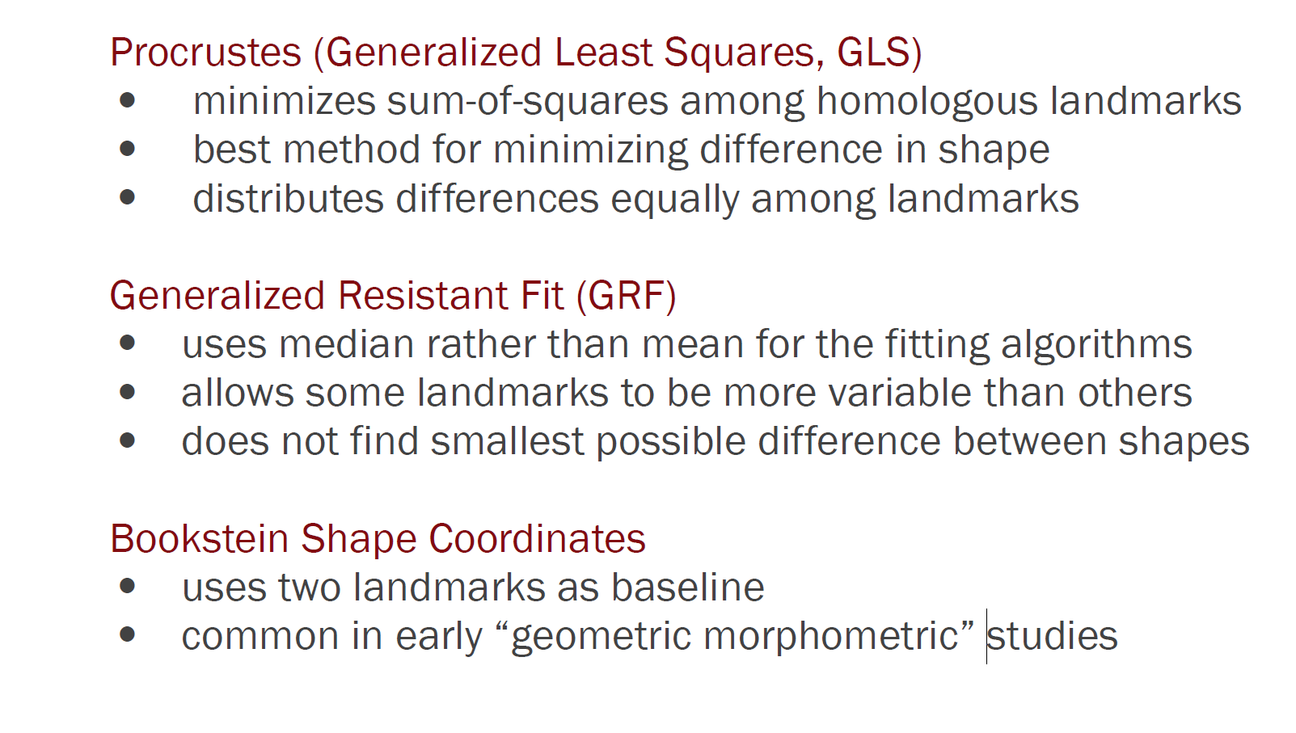
Variations on a theme of Procrustes
GPA implementation of SlicerMorph (with the option of skipping scaling step).

Slide 17
Euclidean Distance Matrix Analysis (EDMA)
Can be useful incase/control study designs.
Exploratory Method to identify significantly different differences between groups.
All possible pairwise landmark distances are calculated. For N landmarks there are [Nx(N-1)]/2 pairwise distance. 5 LMs=20 pairwise distances
‘Pinocchio Effect’
Lele S, Richtsmeier J. 1991. Euclidean Distance Matrix Analysis - a Coordinate-Free Approach for Comparing Biological Shapes Using Landmark Data. Am J Phys Anthropol 86:415–427.

Slide 18
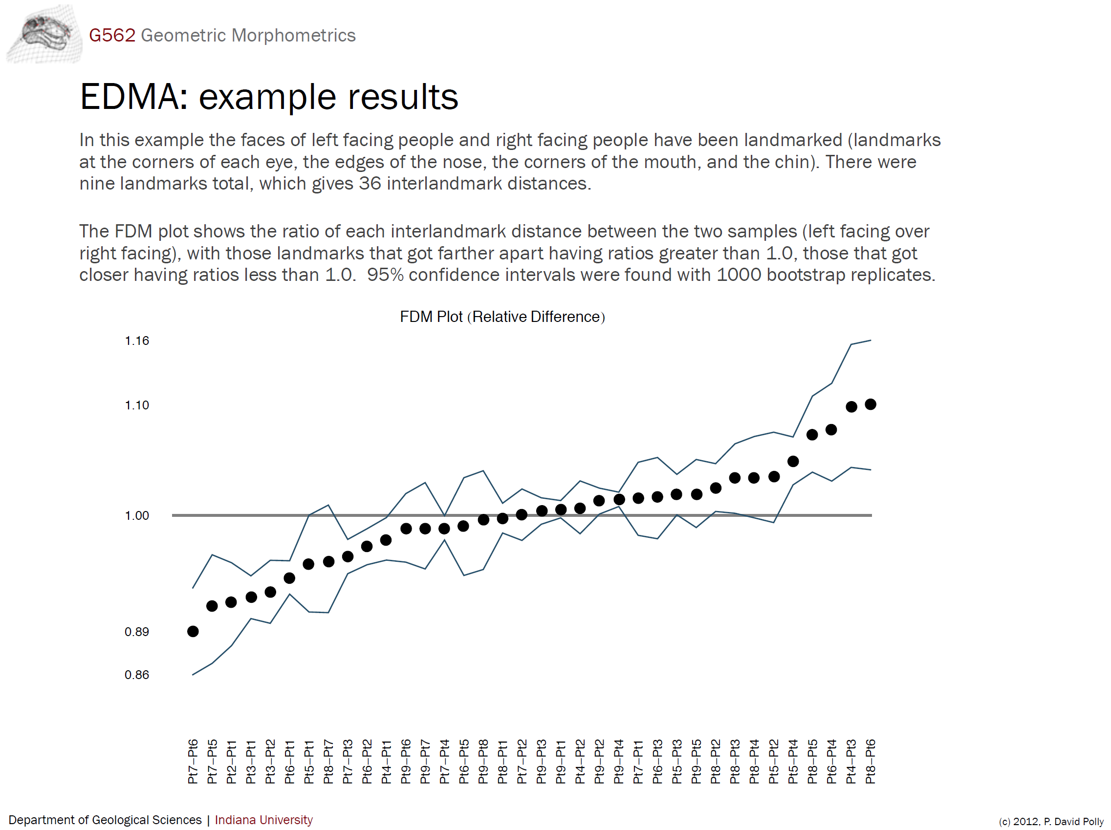
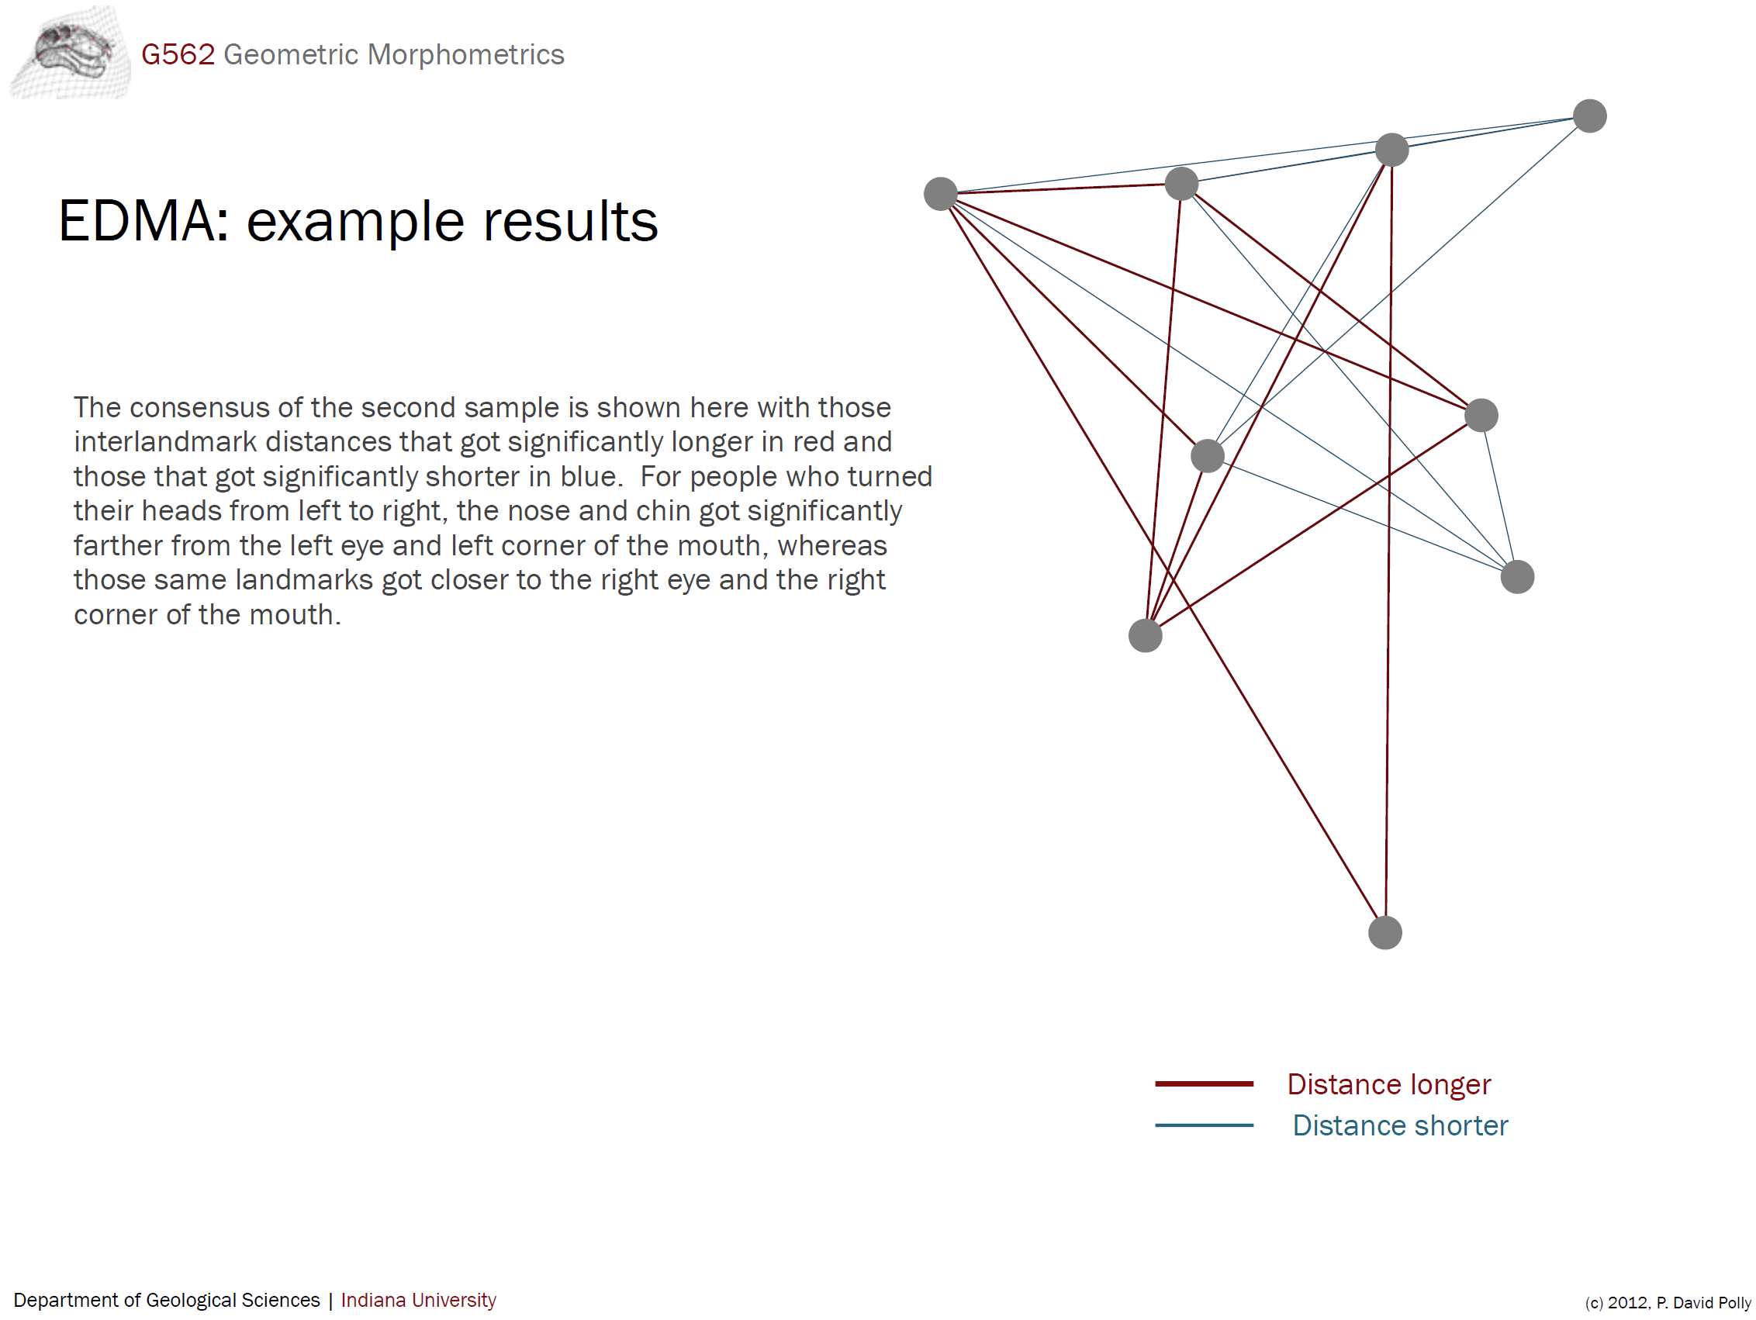
Euclidean Distance Matrix Analysis

Slide 19
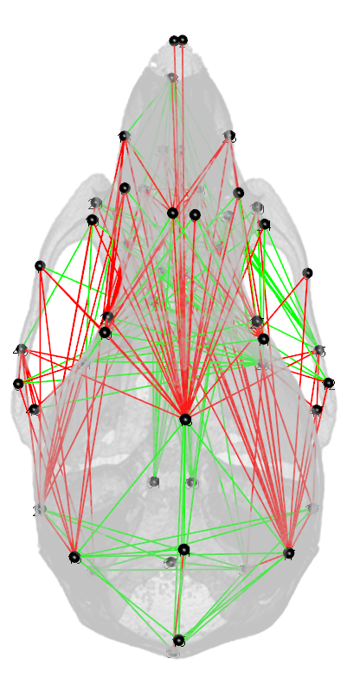
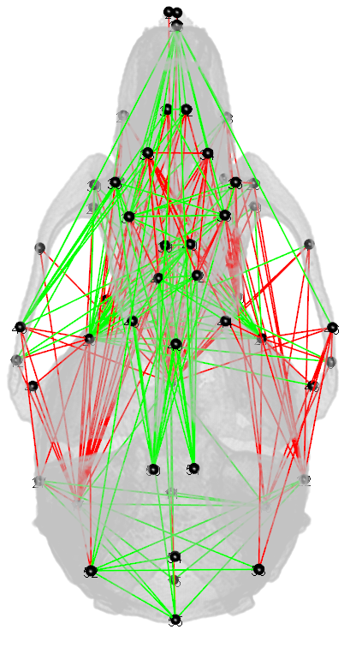
Effect of gestational (E0-E8) chronic alcohol exposure on skull development
Distances significantly smaller in EtOH group
Distances significantly larger in EtOH group
Superior / Dorsal view
Inferior / Ventral view
Student Project: EDMA is NOT available in SlicerMorph, but we have a prototype implementation that needs someone with time (and some python coding skills) to finesse and test.

Slide 20
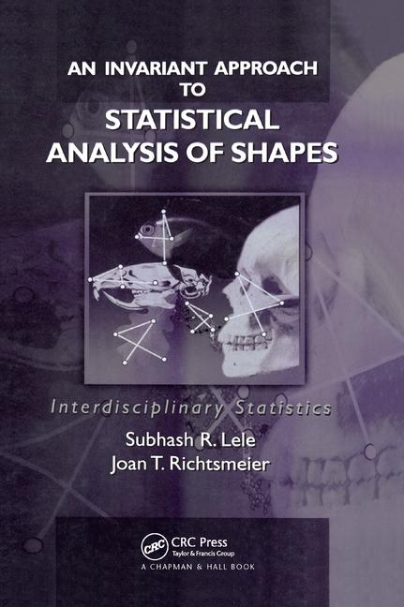
EDMA References:
Lele, Subhash, and Joan T. Richtsmeier. “Statistical Models in Morphometrics: Are They Realistic?” Systematic Zoology 39, no. 1 (March 1, 1990): 60–69. https://doi.org/10.2307/2992208.
Lele, S., and Jt Richtsmeier. “Euclidean Distance Matrix Analysis - a Coordinate-Free Approach for Comparing Biological Shapes Using Landmark Data.” American Journal of Physical Anthropology 86, no. 3 (November 1991): 415–27. https://doi.org/10.1002/ajpa.1330860307.
Lele, S., and T. M. Cole III. “A New Test for Shape Differences When Variance–Covariance Matrices Are Unequal.” Journal of Human Evolution 31, no. 3 (September 1996): 193–212. https://doi.org/10.1006/jhev.1996.0057.
Lele, Subhash R, and Charles E McCulloch. “Invariance, Identifiability, and Morphometrics.” Journal of the American Statistical Association 97, no. 459 (September 1, 2002): 796–806. https://doi.org/10.1198/016214502388618609.

Slide 21
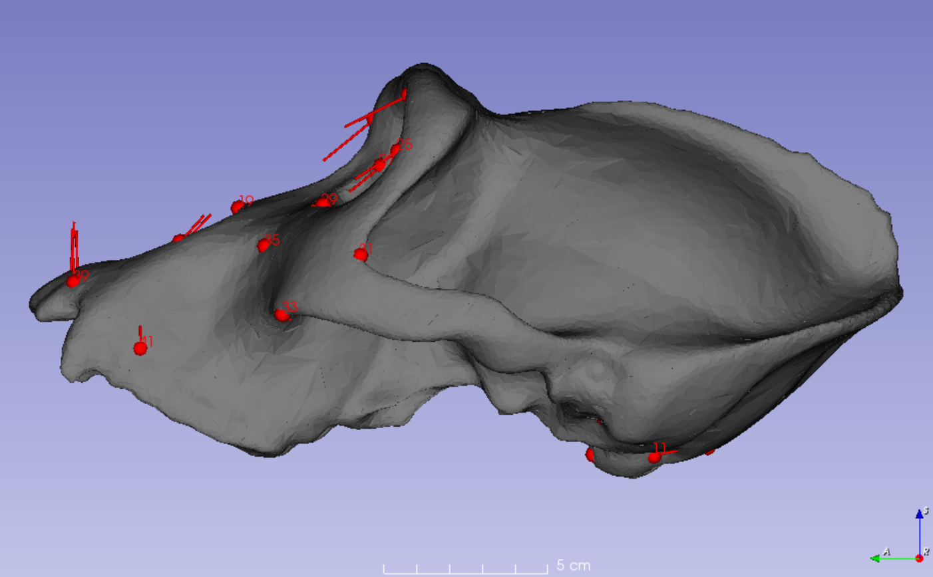
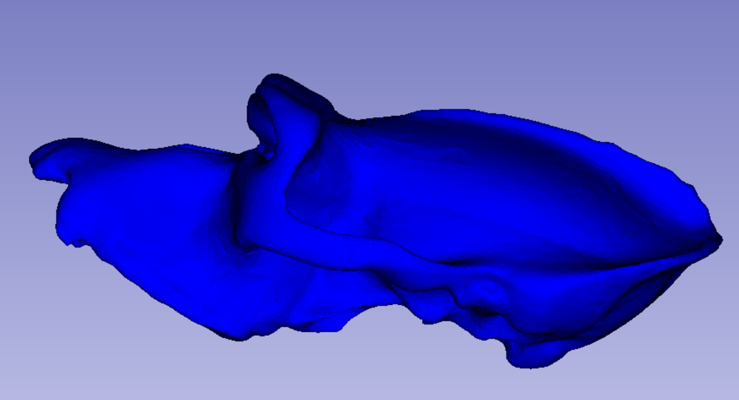
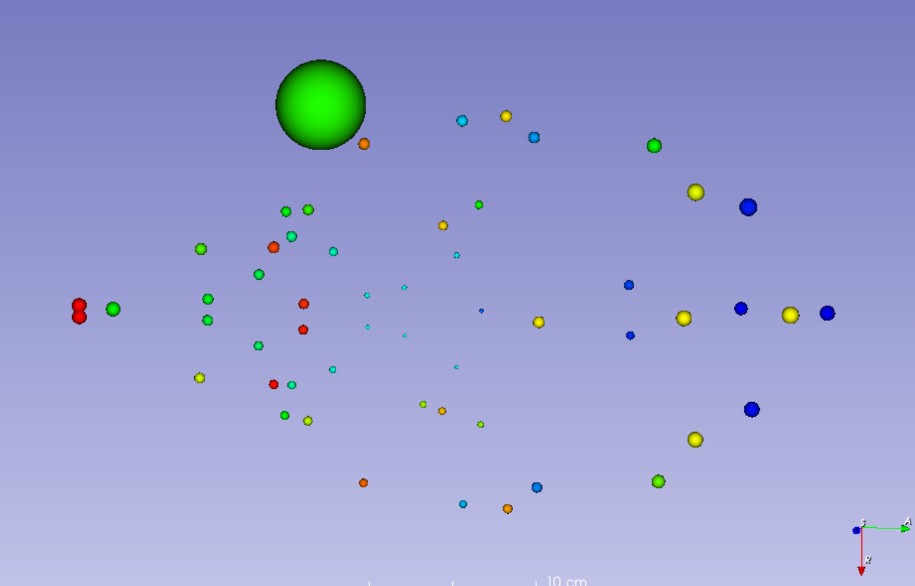
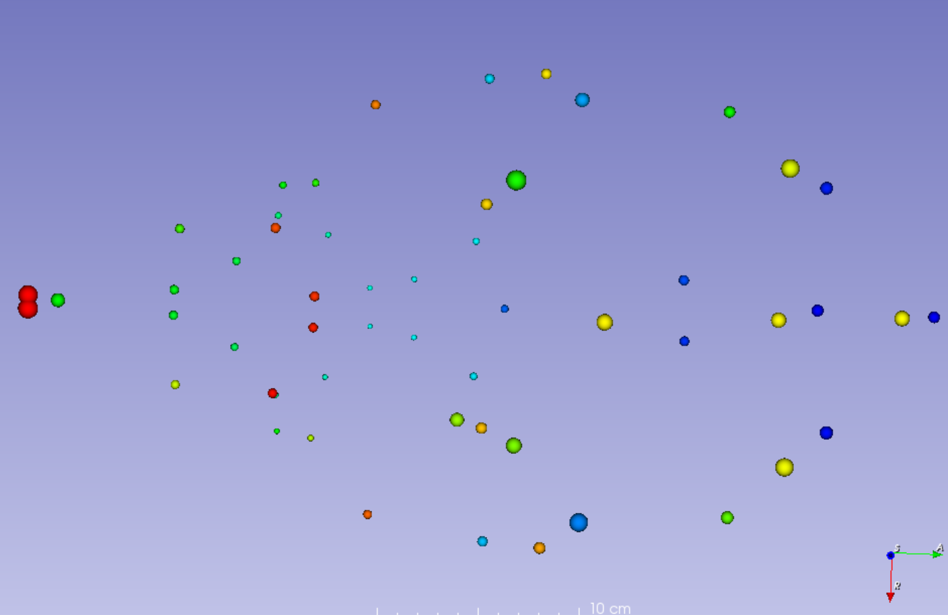
Visualizing Geometric Morphometrics

Slide 22
What does PCA do?
1. Rotates data to its major axes for easier visualization
2. Preserves original distances between data points (in other words, PCA does not distort the variation data, but only if the covariance method is used, which is standard in geometric morphometrics)
3. Removes correlations between variables to make further statistical analysis simpler
4. Can be a tool for ‘noise’ removal.

Slide 23
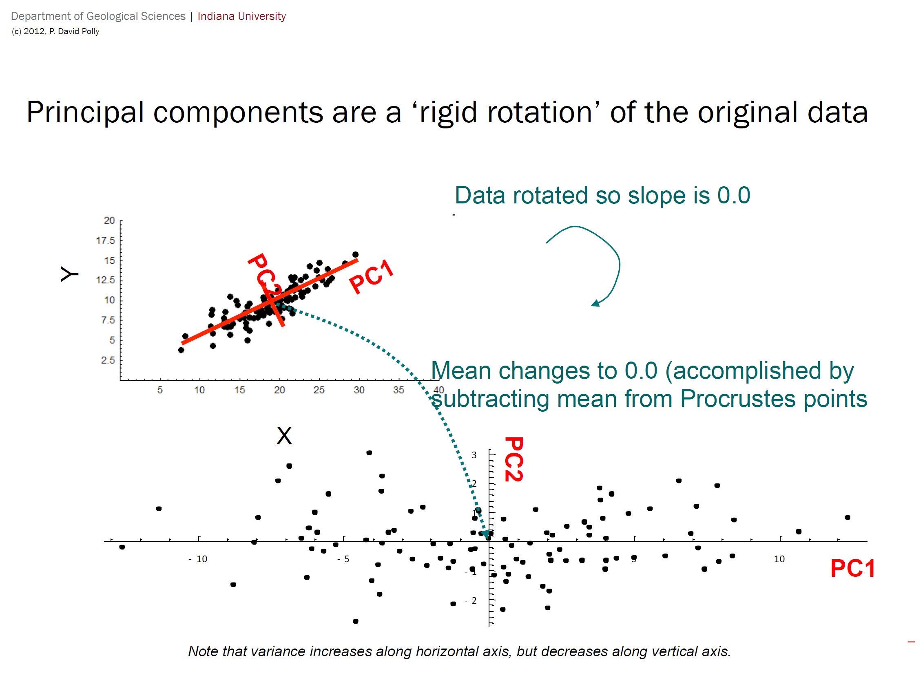

Slide 24
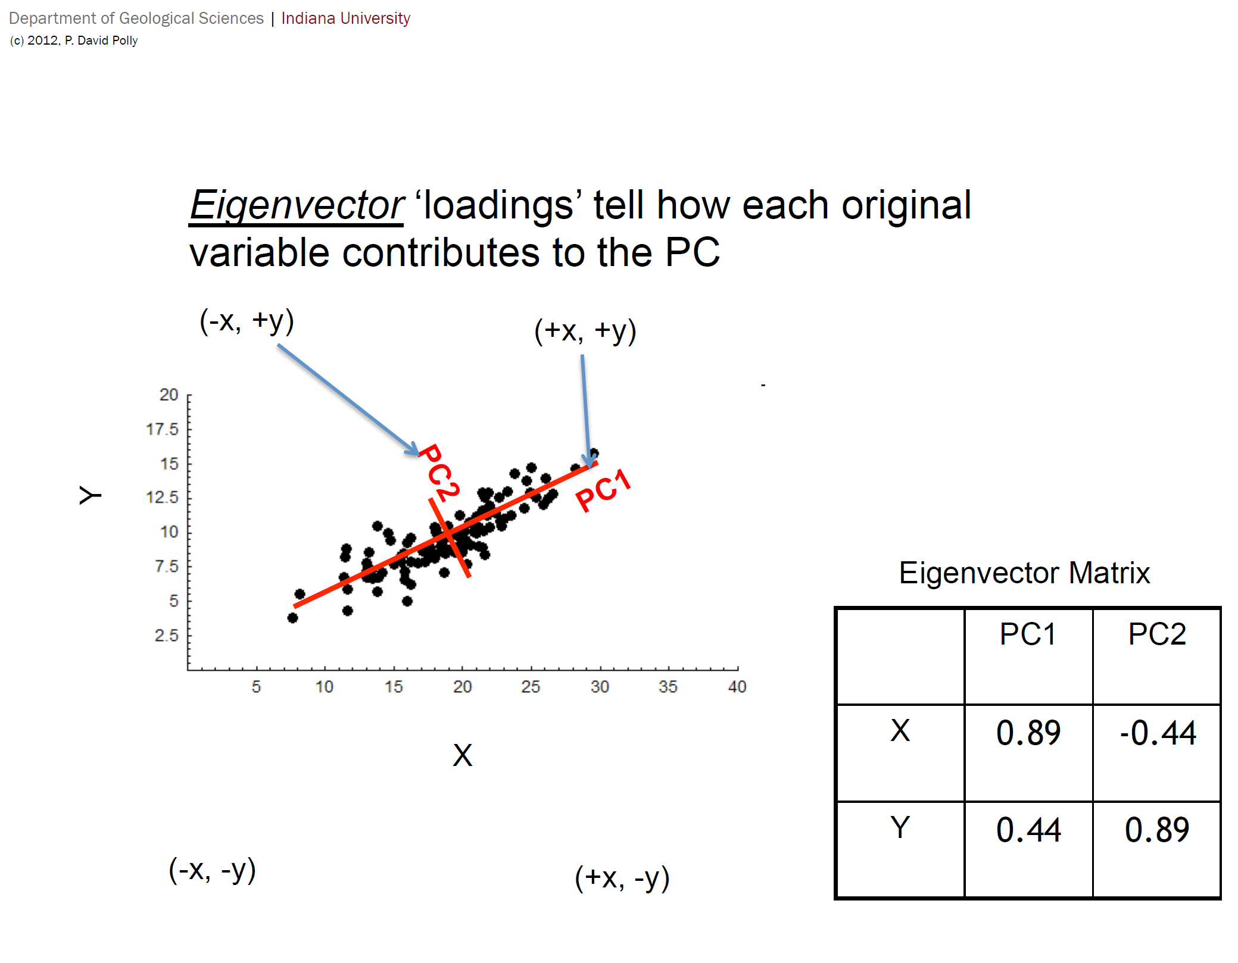

Slide 25
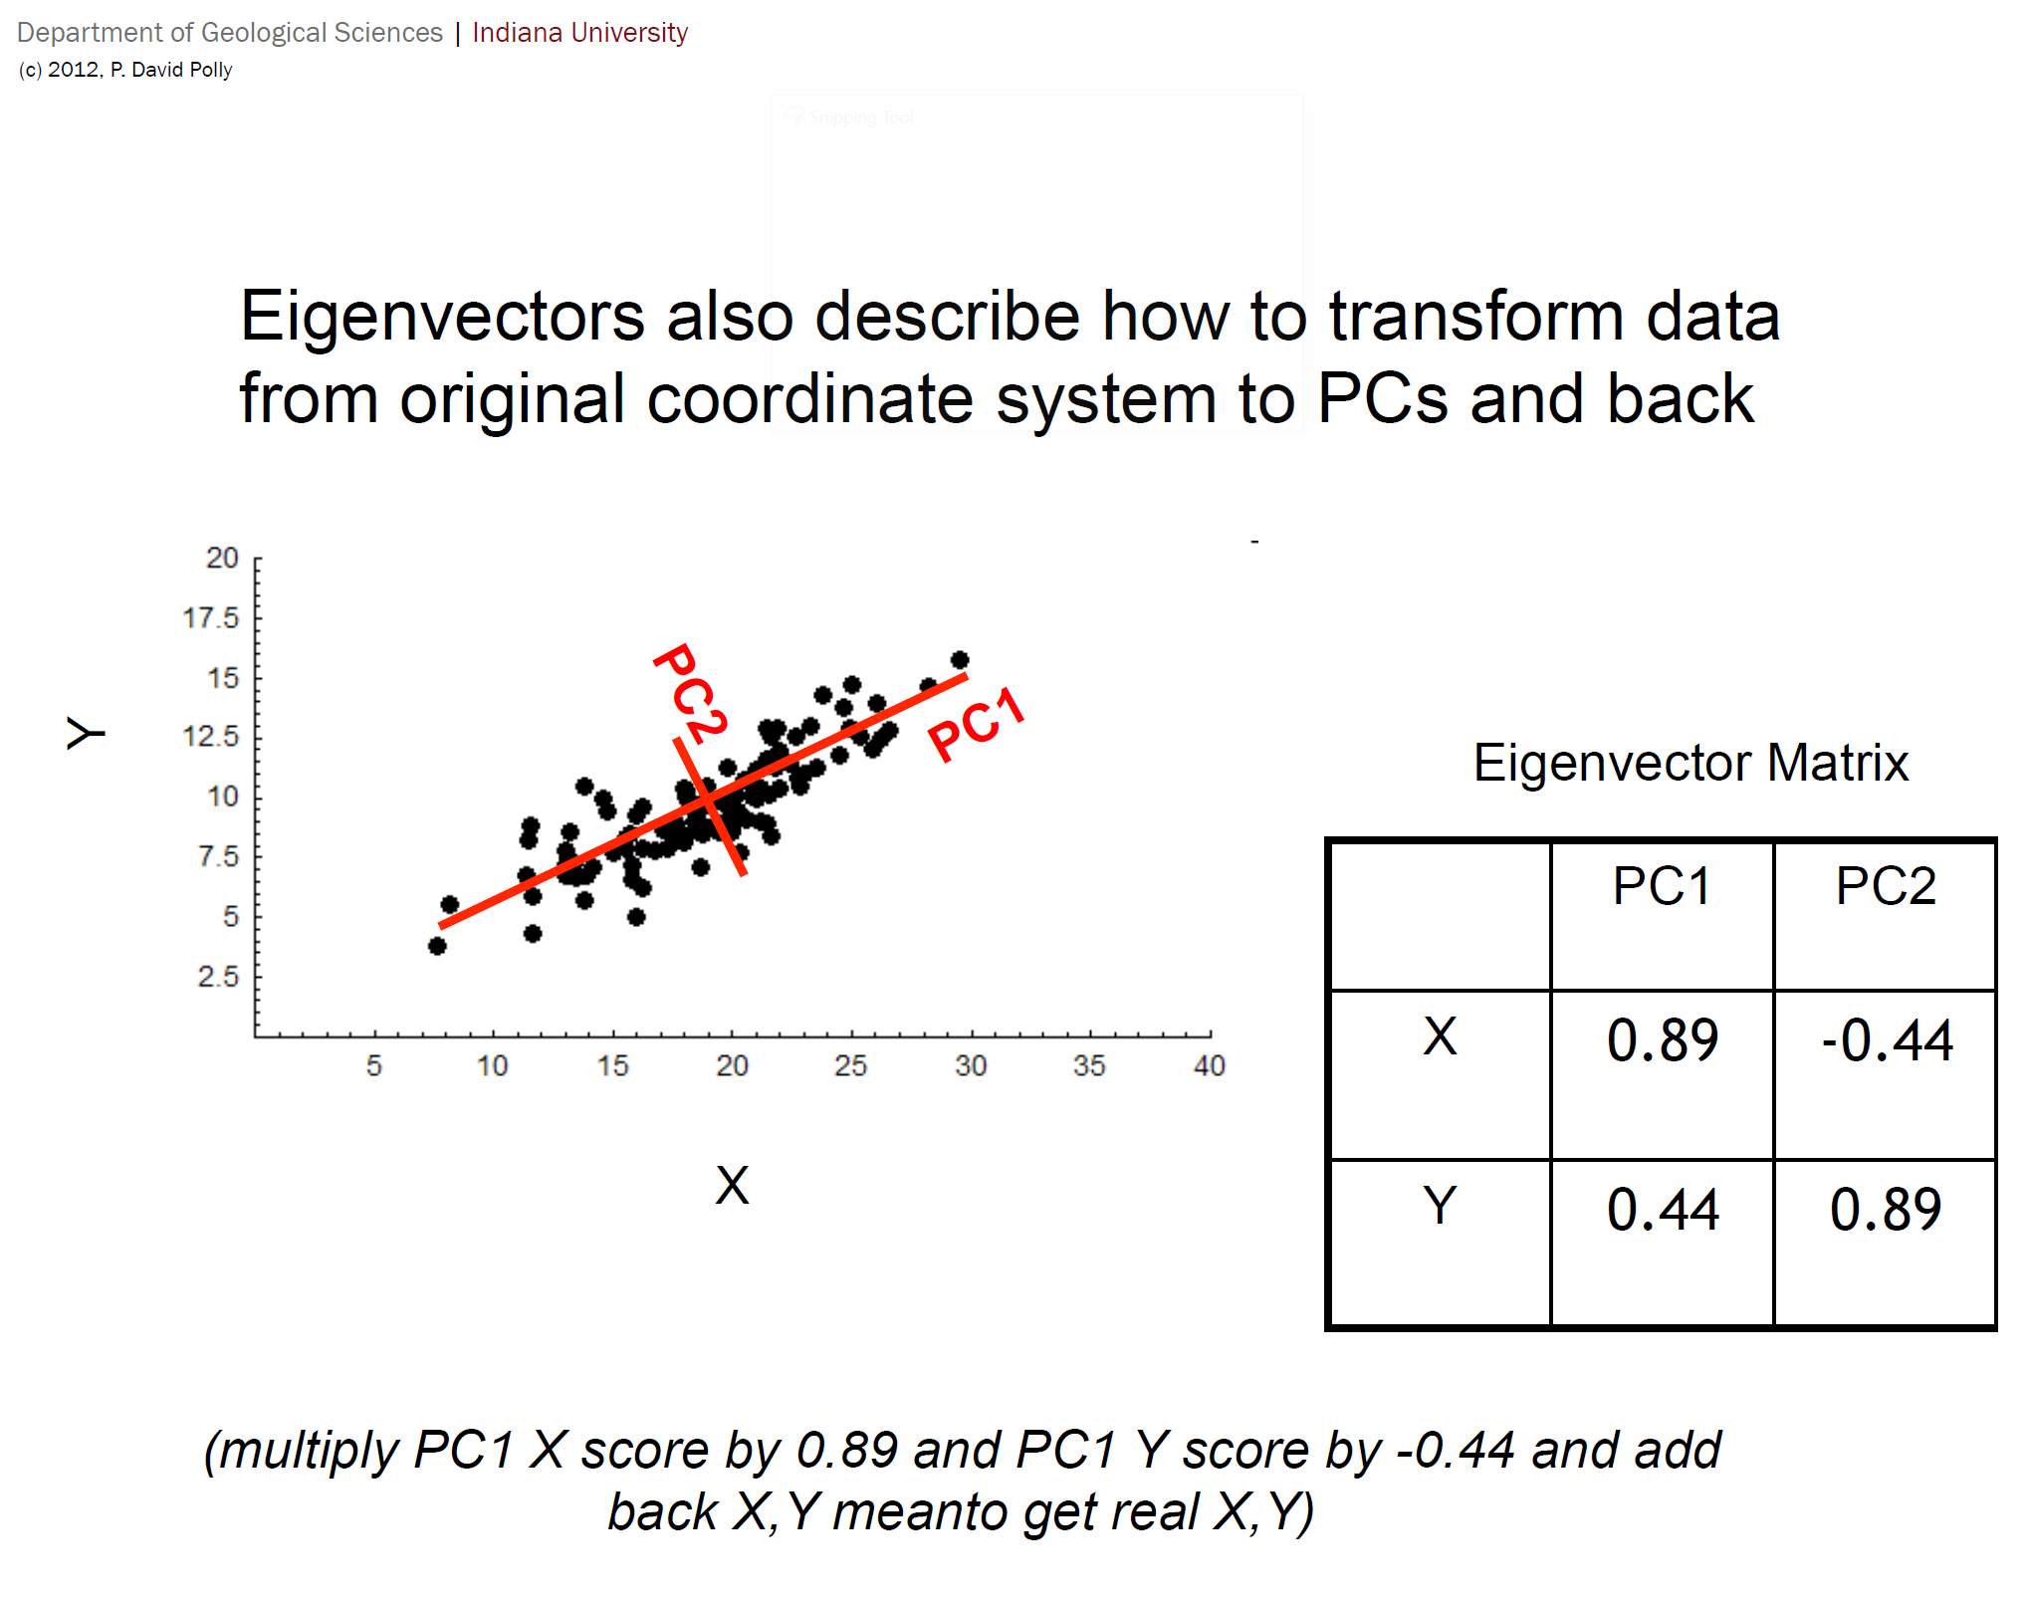

Slide 26
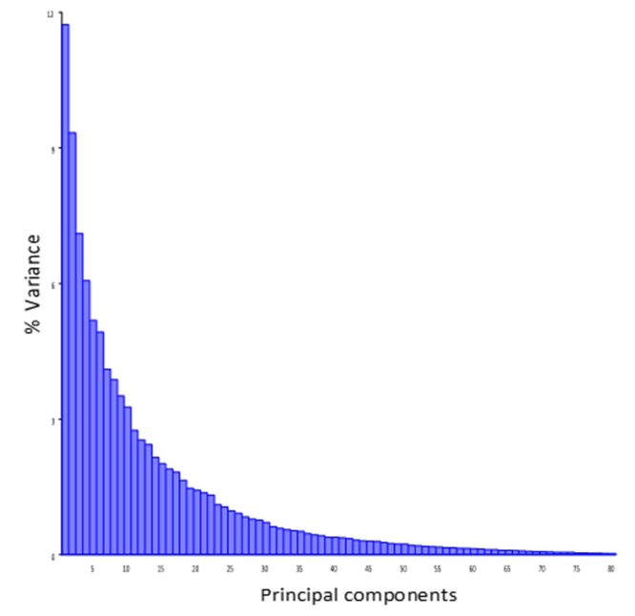
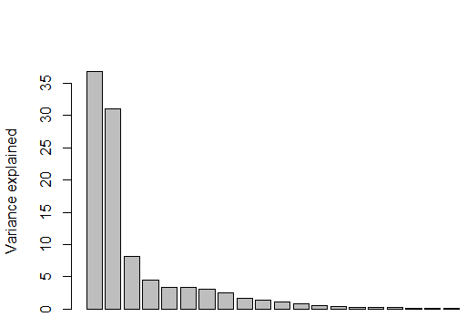
Principle Components are ranked by variance
Plethodon Dataset from Geomorph
Mouse skulls from Maga et al. 2015

Slide 27
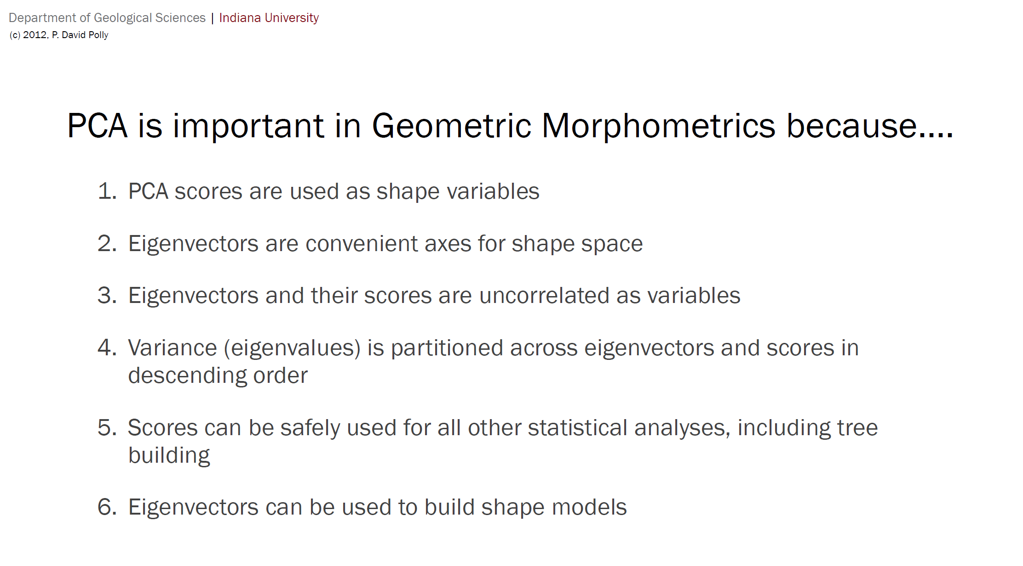

Slide 28
PCs themselves have 0 (zero) inherent biological meaning. They are NOT traits.

Slide 29
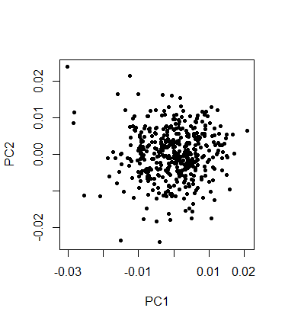
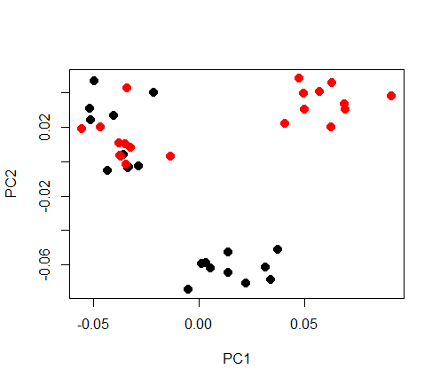
…but some PCA results are more interpretable than others
PC2~ 8% of all shape variance
PC2~ 30% of all shape variance
PC1 ~ 12% of all shape variance
PC1 ~ 35% of all shape variance
Plethodon skull Dataset from Geomorph
Adams 2004, Ecology 85, no. 10:2664–70.
Mouse skulls from Maga et al. 2015. Frontiers in Physiology

Slide 30
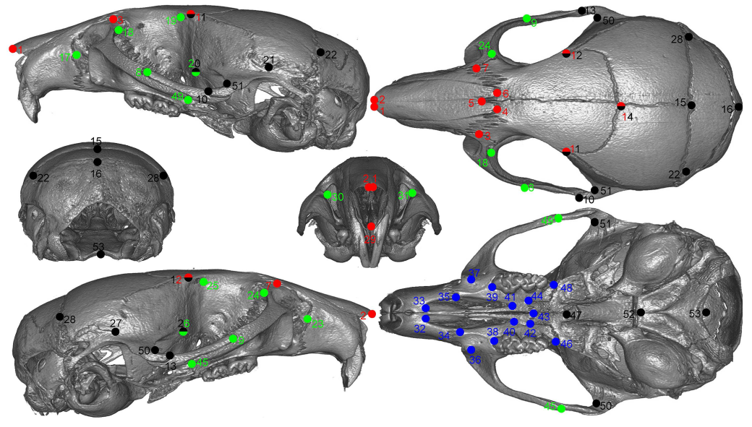
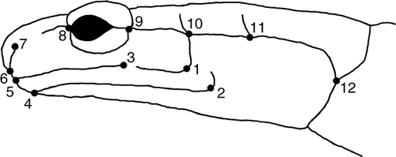
How many landmarks to use?
12 LMs in 2D coordinates
53 LMs in 3D coordinates
Plethodon skull Dataset from Geomorph
Adams 2004, Ecology 85, no. 10:2664–70.
Mouse skulls from Maga et al. 2015

Slide 31
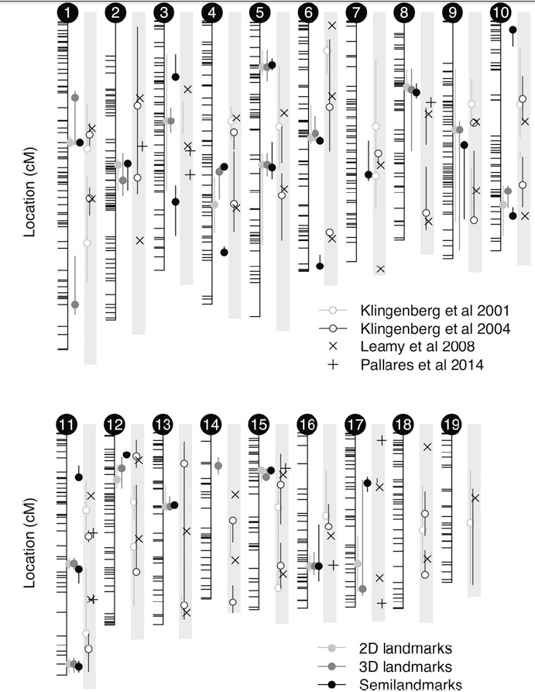
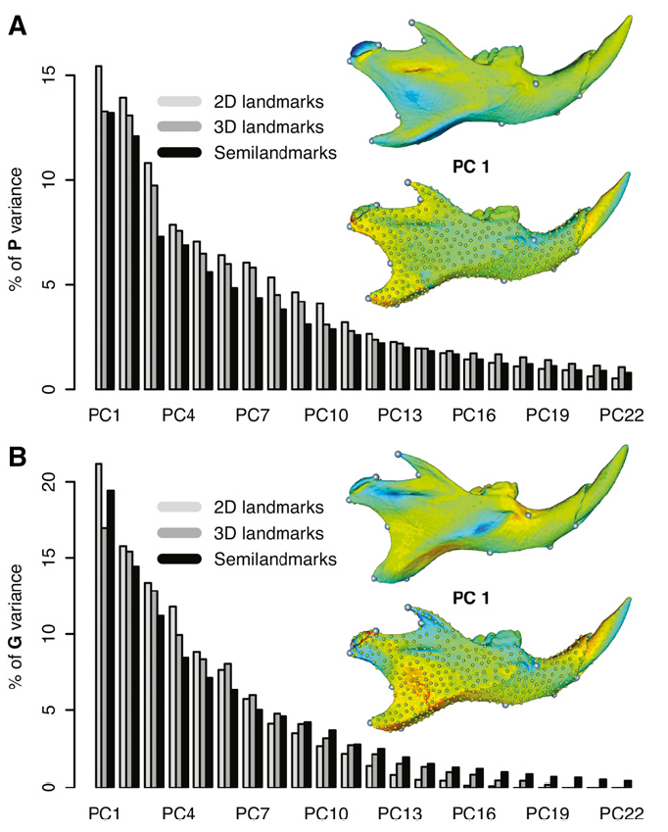
2D vs 3D?
Navarro, Nicolas, and A. Murat Maga. “Does 3D Phenotyping Yield Substantial Insights in the Genetics of the Mouse Mandible Shape?” G3: Genes, Genomes, Genetics 6, no. 5 (May 1, 2016): 1153–63. https://doi.org/10.1534/g3.115.024372.

Slide 32
Curse of dimensionality
The curse of dimensionality: When the dimensionality increases, the volume of the space increases so fast that the available data become sparse.
12 LMs in 2D = 20 dimensional space (24 variables - 4 DOF lost due to superimposition, scaling and rotation)
53 LMs in 3D = 152 dimensional space (159 variable - 7 DOF lost due to superimposition, scaling and rotation)
As a rule of thumb, you need at least sample size > your variable space
(in practice you often need sample size >>> your variable space, e.g., in mouse crosses)

Slide 33
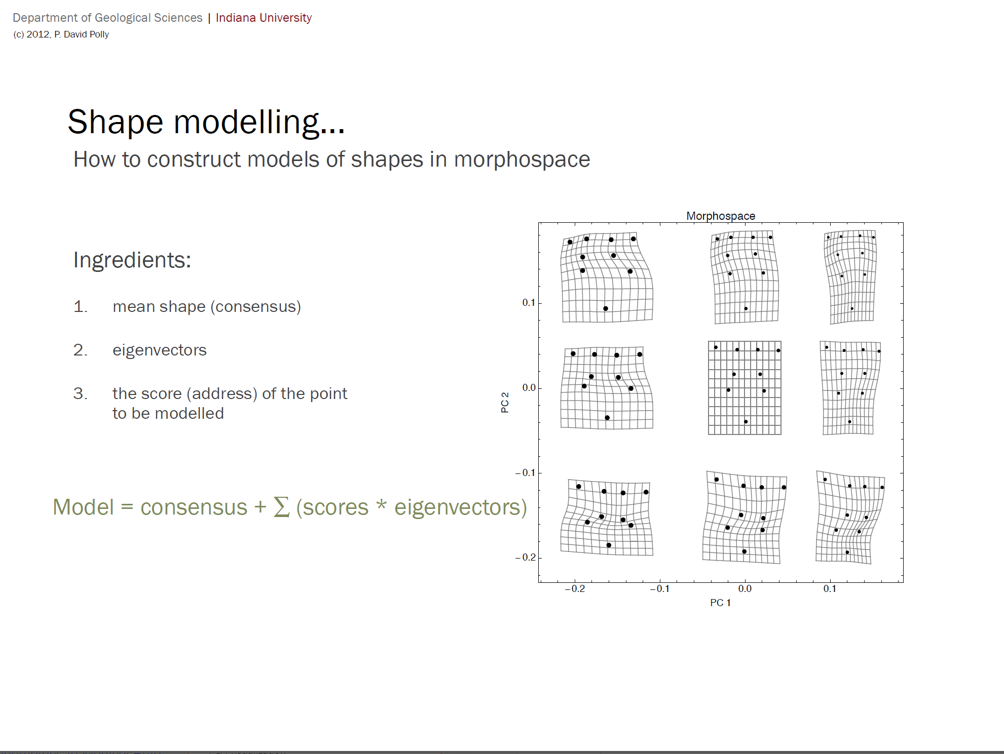

Slide 34
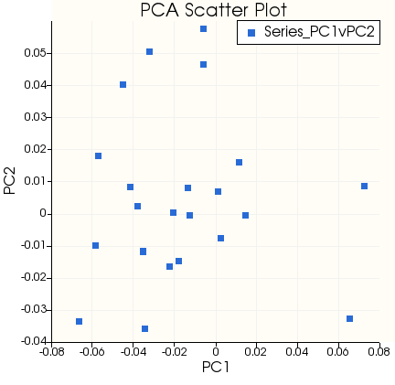
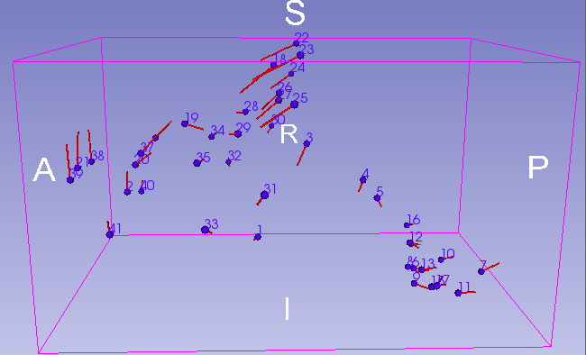
Visualizing PCA results

Slide 35
Some other analyses on GM data
Study of variability (Procrustes anova)
Study of symmetry
Study of allometry
Study of modularity and integration
Study of covariance through partial-least squares
Study of phylogenetics (we have a specific lecture on that)

Slide 36
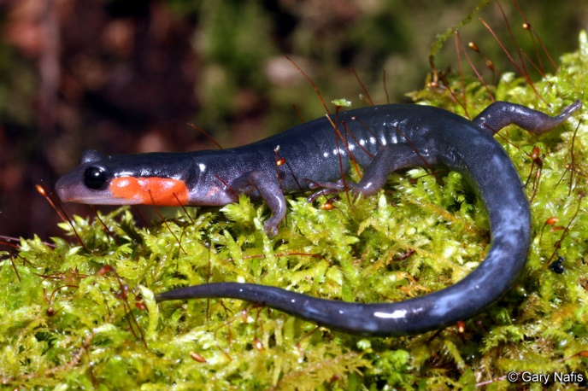
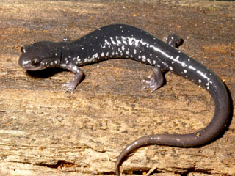
Procrustes ANOVA
Statistical assessment of the terms in the model using Procrustes distances among specimens. Sum-of-squared Procrustes distances are used as a measure of SS. The observed SS are evaluated through permutation. In morphometrics this approach is known as a Procrustes ANOVA
Output of the code
Analysis of Variance, using Residual Randomization
Permutation procedure: Randomization of null model residuals
Number of permutations: 1000
Estimation method: Ordinary Least Squares
Sums of Squares and Cross-products: Type I
Effect sizes (Z) based on SS distributions
Df SS MS Rsq F Z Pr(>SS)
species 1 0.029258 0.0292578 0.14856 6.6304 3.1637 0.001 **
Residuals 38 0.167682 0.0044127 0.85144
Total 39 0.196940
---
Signif. codes: 0 ‘***’ 0.001 ‘**’ 0.01 ‘*’ 0.05 ‘.’ 0.1 ‘ ’ 1
Call: procD.lm(f1 = coords ~ species, iter = 999, data = gdf)
### Example from geomorph
#conduct GPA-alignment
Y.gpa <- gpagen(plethodon$land)
# construct a geomorph data frame
gdf <- geomorph.data.frame(Y.gpa, site = plethodon$site, species = plethodon$species)
procD.lm(coords ~ species, data = gdf, iter = 999)
Goodall C. 1991. Procrustes Methods in the Statistical Analysis of Shape. Journal of the Royal Statistical Society Series B (Methodological) 53:285–339.

Slide 37
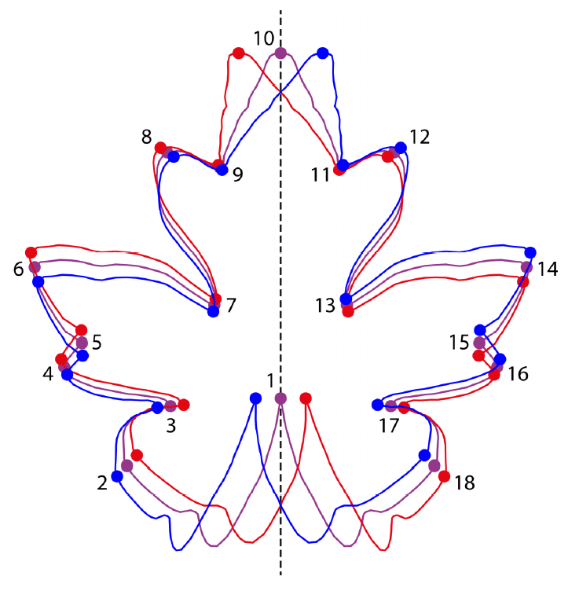
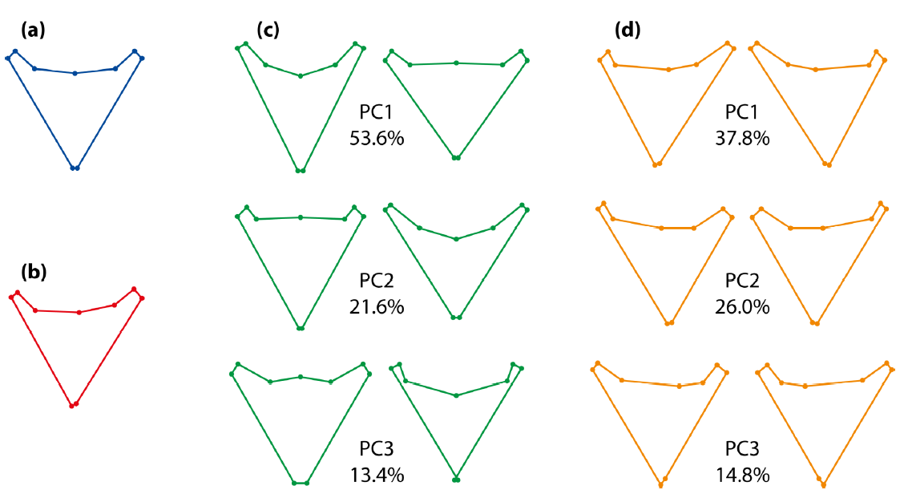
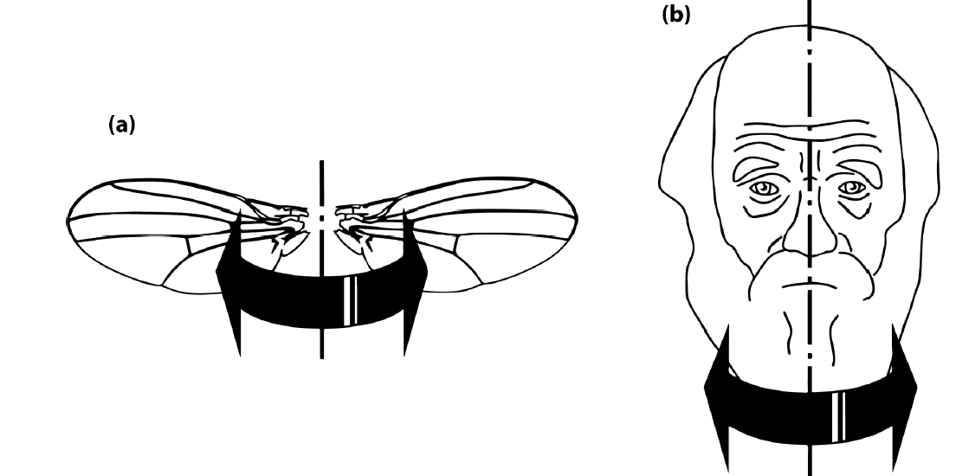
Analysis of symmetry with geometric morphometrics
Symmetrized
mean shape
PCA on
Symmetric component
PCA on
Asymmetric component
Types of symmetry
Matching
Object
Original configuration
Reflected and relabed
Symmetrized
Mean asymmetry
(DA)
Directional asymmetry (DA) is the mean asymmetry in the population, and therefore can be estimated as the average of individual left–right shape differences over all the individual. Or equivalently, as the difference between the average of all left configurations and the average of all right configurations.
Fluctuating asymmetry (FA) is the variation of individual asymmetries around the average of directional asymmetry, and thus can be computed as each individual’s left–right shape difference minus the overall average of the left–right shape differences.
FA Score: Sqrt of sum of an individual’s FA^2 (akin to Procrustes distance), is a metric used in studies of asymmetry and developmental instability.
Klingenberg CP. 2015. Analyzing Fluctuating Asymmetry with Geometric Morphometrics: Concepts, Methods, and Applications. Symmetry 7:843–934.
Klingenberg CP, Barluenga M, Meyer A. 2002. Shape Analysis of Symmetric Structures: Quantifying Variation Among Individuals and Asymmetry. Evolution 56:1909–1920.

Slide 38
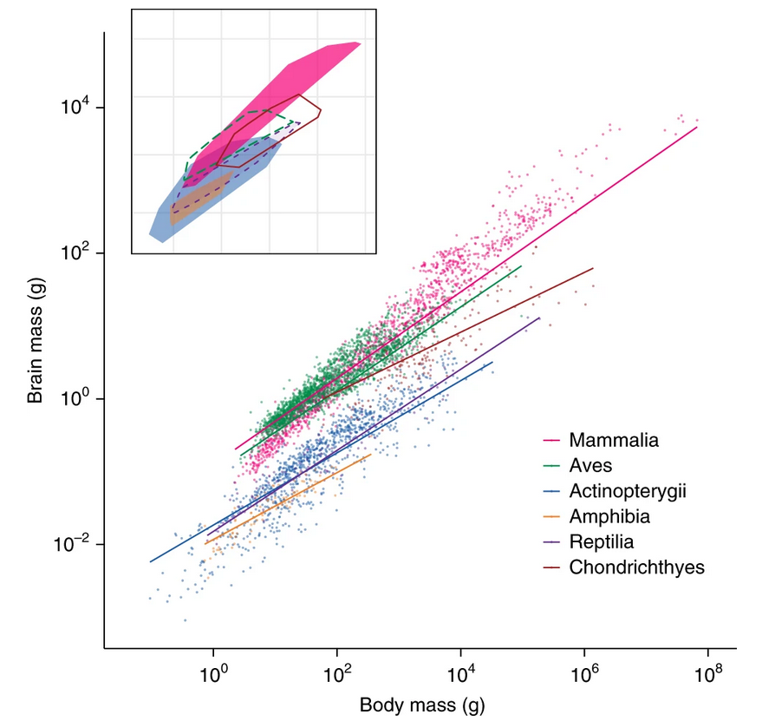

Allometry

Slide 39
Study of allometry with geometric morphometrics
For studying allometry with geometric morphometric data, the most straightforward method is to use a multivariate regression of the shape variables onto a measure of size (Monteiro 1999).
The shape variables are the Procrustes aligned coordinates of the specimens and the shape measure is centroid size (or the logarithm of centroid size.)
Test whether there is allometry by examining whether size and shape are correlated statistically. If so, the patterns of allometry can be characterized as the expected shape change per unit of increase in size. Multivariate regression and the tests associated with it can perform both those tasks.
Compute regression scores by projecting the data points in shape space onto an axis in the direction of the regression vector (Drake and Klingenberg 2008). This is the shape variable that has the maximal covariation with centroid size (or log-transformed centroid size, if that was used as the independent variable) and is therefore an optimal summary variable.
Monteiro LR. 1999. Multivariate regression models and geometric morphometrics: the search for causal factors in the analysis of shape. Syst Biol 48:192–199.
Drake AG, Klingenberg CP. 2008. The pace of morphological change: historical transformation of skull shape in St Bernard dogs. Proc Biol Sci 275:71–76.
Klingenberg CP. 2016. Size, shape, and form: concepts of allometry in geometric morphometrics. Dev Genes Evol 226:113–137.

Slide 40



Effect of skull size on the skull shape
Maga AM, Navarro N, Cunningham ML, Cox TC. 2015. Quantitative trait loci affecting the 3D skull shape and size in mouse and prioritization of candidate genes in-silico. Frontiers in Physiology | Craniofacial Biology 6:92.

Slide 41





Pyridoxine dependent epilepsy and Corpus callosum growth
Mean PDE cases
Mean Controls
PDE growth
Control growth
Log10 transformed
Oesch G, Maga AM, Friedman SD, Poliachik SL, Budech CB, Wright JN, Bok LA, Gospe SM. 2018. Neurology. Jul 3;91(1):e78-e86.

Slide 42


Modularity and integration
A system is modular, if it can be divided into multiple sets of strongly interacting parts that are relatively autonomous with respect to each other.
Typical examples:
splanchnocranium (face) vs neurocranium
Ascending ramus vs body of mandible

Slide 43



Modularity in zebrafish skull
Parsons Kevin J., Son Young H., Crespel Amelie, Thambithurai Davide, Killen Shaun, Harris Matthew P., and Albertson R. Craig. “Conserved but Flexible Modularity in the Zebrafish Skull: Implications for Craniofacial Evolvability.” Proceedings of the Royal Society B: Biological Sciences 285, no. 1877 (April 25, 2018): 20172671. https://doi.org/10.1098/rspb.2017.2671.

Slide 44
Some key literature on landmark based statistical shape analysis
Adams DC, Rohlf FJ, Slice DE. 2013. A field comes of age: geometric morphometrics in the 21st century. Hystrix 24:7–14.
Adams, Dean C. “Evaluating Modularity in Morphometric Data: Challenges with the RV Coefficient and a New Test Measure.” Methods in Ecology and Evolution, January 1, 2016, n/a-n/a. https://doi.org/10.1111/2041-210X.12511.
Bookstein FL. 1989. Principal warps: thin-plate splines and the decomposition of deformations. IEEE Transactions on Pattern Analysis and Machine Intelligence 11:567–585.
Bookstein FL. 1997. Landmark methods for forms without landmarks: morphometrics of group differences in outline shape. Medical Image Analysis 1:225–243.
Drake AG, Klingenberg CP. 2008. The pace of morphological change: historical transformation of skull shape in St Bernard dogs. Proc Biol Sci 275:71–76.
Klingenberg CP, Barluenga M, Meyer A. 2002. Shape Analysis of Symmetric Structures: Quantifying Variation Among Individuals and Asymmetry. Evolution 56:1909–1920.
Klingenberg CP. 1998. Heterochrony and allometry: the analysis of evolutionary change in ontogeny. Biological Reviews 73:79–123.
Klingenberg CP. 2009. Morphometric integration and modularity in configurations of landmarks: tools for evaluating a priori hypotheses. Evol Dev 11:405–421.
Klingenberg CP. 2010. Evolution and development of shape: integrating quantitative approaches. Nat Rev Genet 11:623–635.
Klingenberg CP. 2016. Size, shape, and form: concepts of allometry in geometric morphometrics. Dev Genes Evol 226:113–137.
Lele S, Richtsmeier J. 1991. Euclidean Distance Matrix Analysis - a Coordinate-Free Approach for Comparing Biological Shapes Using Landmark Data. Am J Phys Anthropol 86:415–427.
Lele S, Richtsmeier JT. 1995. Euclidean distance matrix analysis: confidence intervals for form and growth differences. Am J Phys Anthropol 98:73–86.
Rohlf FJ, Corti M. 2000. Use of two-block partial least-squares to study covariation in shape. Syst Biol 49:740–753.
Rohlf FJ, Slice D. 1990. Extensions of the Procrustes Method for the Optimal Superimposition of Landmarks. Systematic Zoology 39:40–59.
Rohlf FJ. 2000. On the use of shape spaces to compare morphometric methods. Hystrix-Italian Journal of Mammalogy 11:9–25.

Slide 45
What can you do with SlicerMorph GPA module?
GPA in SlicerMorph will provide
Procrustes distances
Aligned Procrustes coordinates
Centroid sizes
2D/3D plot of mean shapes
Variance of each individual landmark (not for analysis, but for QC)
PCA and PC scores
2D/3D eigenvectors (lollipop plots)
Visualization along PCA axes
Deformation of a reference shape model along PC axes using TPS
3D animations of PCA results
SlicerMorph won’t currently do:
Procrustes anova
Multivariate regression of shape coordinates on CS
Symmetry analysis
Modularity/Integration
Essentially any sort of statistics based on analysis of coordinate data
Import the output from GPA into R and do all these analyses in geomorph/shapes/Morpho packages.

